Slide 1



INTRODUCTION TO PHISHING ATTACKS
Phishing attacks are a type of cybercrime that uses deceptive tactics to trick users into revealing sensitive information like passwords, credit card details, and personal data.

Slide 2

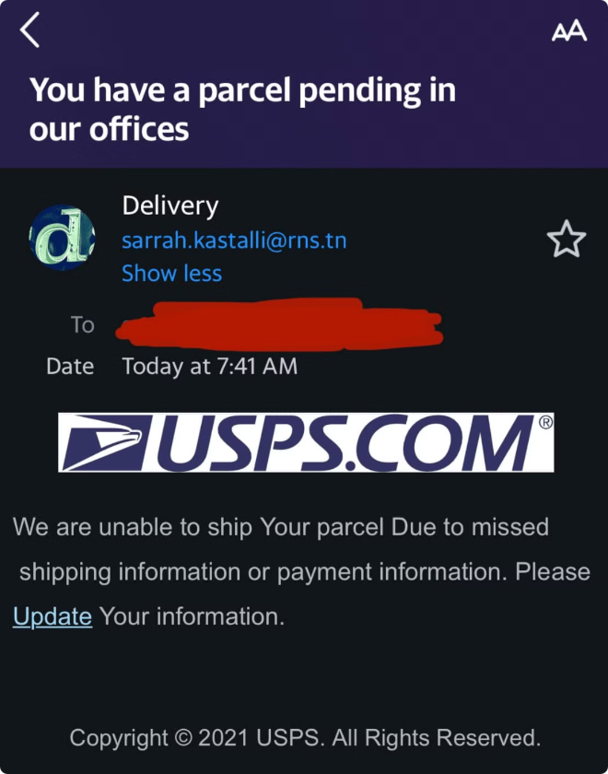
Understanding Phishing Tactics
1
Impersonation
Attackers often impersonate legitimate organizations like banks, government agencies, or social media platforms.
2
Urgency and Scarcity
They create a sense of urgency or scarcity, pressuring victims to take immediate action without thinking critically.
3
Social Engineering
Attackers use psychological manipulation techniques to exploit human vulnerabilities and gain trust from their victims.
4
Malicious Links and Attachments
Phishing emails may contain malicious links or attachments that, when clicked or opened, can install malware on the victim's device.

Slide 3
Recognizing Phishing Emails
Suspicious Sender
Grammar and Spelling Errors
Urgent or Threatening Language
Check the sender's email address and domain name. Is it misspelled? Does it seem unfamiliar or suspicious?
Phishing emails often contain grammatical errors, typos, or poor formatting.
Phishing emails may use alarming language to pressure victims into taking immediate action.

Slide 4





Identifying Phishing Websites
Unfamiliar URL
Look closely at the URL. Does it seem suspicious? Are there any misspellings or strange characters?
Mismatched Domain and Content
Does the website's content match the domain name? For example, a website about banking should not have content related to fashion or entertainment.
Security Certificates
Check for a valid HTTPS certificate, indicated by a padlock icon in the address bar. Look for any certificate warnings.

Slide 5


Protecting Against Social Engineering
Think Before Clicking
Before clicking on any links or attachments, take a moment to consider the source and the message.
Verify Information
If you receive a suspicious email, contact the organization directly to verify the information. Do not rely on the information in the email alone.
Be Wary of Free Offers
Be cautious of offers that seem too good to be true. If something sounds suspicious, it probably is.

Slide 6


Best Practices for Phishing Prevention
1
Use Strong Passwords
Create unique, complex passwords for all of your online accounts.
2
Enable Two-Factor Authentication (2FA)
Two-factor authentication adds an extra layer of security by requiring a second form of verification, such as a code sent to your phone.
3
Keep Software Updated
Regularly update your operating system and applications to patch security vulnerabilities.
4
Be Cautious of Social Media
Be mindful of what information you share on social media. Avoid posting personal information that could be used to target you in phishing attacks.

Slide 7


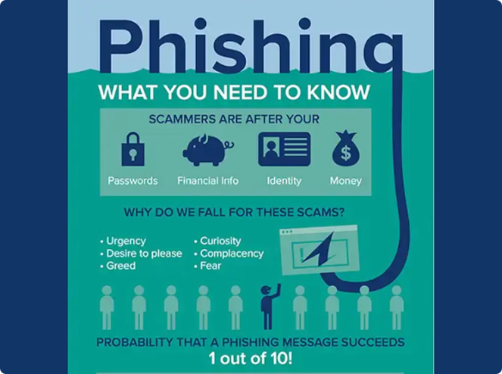



Incident Response and Reporting
Report Suspicious Emails
If you receive a phishing email, report it to your organization's IT security team or to the appropriate authorities.
Change Passwords
If you believe you may have been a victim of a phishing attack, change your passwords for all affected accounts.
Monitor Your Accounts
Check your bank statements and credit card bills for any unauthorized transactions.
Install Anti-Malware Software
Install and maintain anti-malware software on your devices to protect against malicious software.

Slide 8

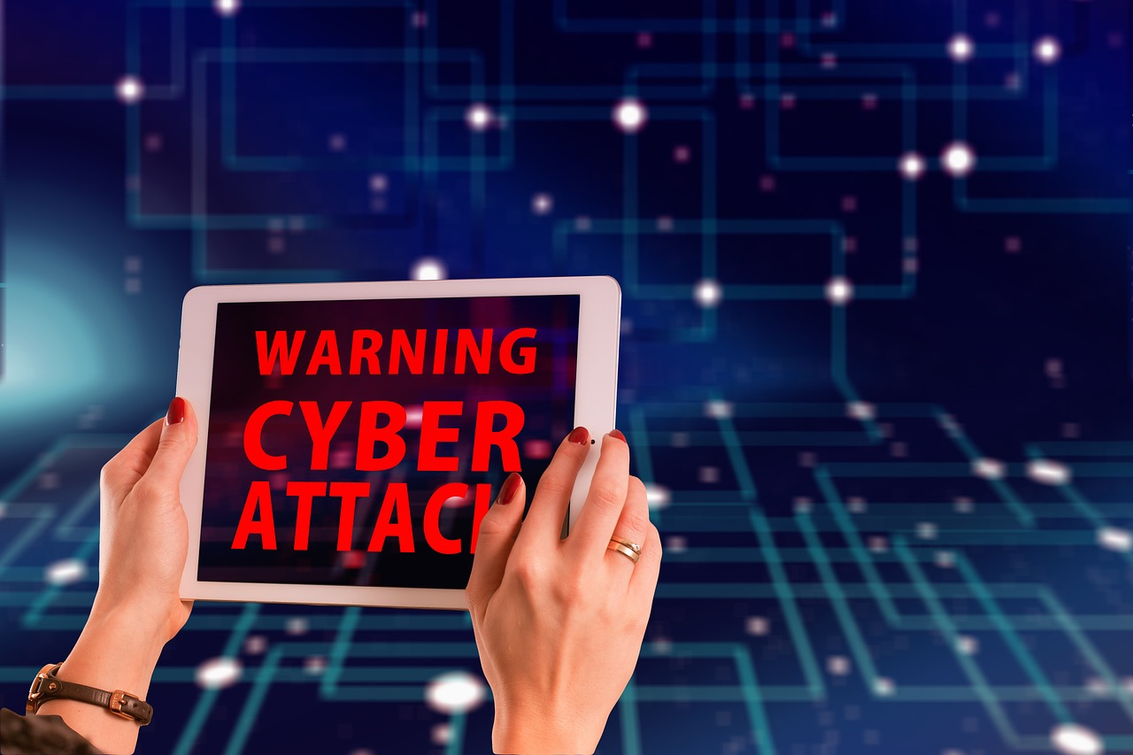
Conclusion and Key Takeaways
Phishing attacks are a serious threat, but by being aware of the risks and following best practices for prevention, you can significantly reduce your chances of becoming a victim. Remember to think critically, verify information, and report suspicious activity to protect yourself and your organization.

